Slide 1
Datacenters – unused slides

Slide 2
Topology #2: Two Smaller Switches
Idea: Each rack is connected to 2 switches.
Reduced bandwidth on each switch. (600 Gbps → 300 Gbps)
Reduced radix on each switch. (6 ports → 3 ports, 100 Gbps each)
Modern chips allow you to "break" a 100 Gbps port into two 50 Gbps ports.
Problem: If one of the switches goes down, we lose half the bandwidth.
600 Gbps
300 Gbps
300 Gbps
Each link is 100 Gbps.
Each link is 50 Gbps.
Topology #1
Topology #2
Notes:
Not sure this slide makes sense.

Slide 3
Topology #3: Many Smaller Switches
Extending the previous idea by adding more switches:
Note: Each switch is still connected to every rack.
Each switch only has to handle a fraction of the bandwidth.
This also reduces the radix of each switch (by "breaking out" ports).
If a switch goes down, we still have most of the bandwidth.
This works (and has been used), though it's still expensive.
150 Gbps
150 Gbps
150 Gbps
150 Gbps
Each link is 25 Gbps.
Switches are 150 Gbps (6 links to 6 racks).
Each rack can send at desired 100 Gbps by splitting across 4 paths.
Notes:
Not sure this slide makes sense.

Slide 4
Topology #6: Spine-Leaf
Increase link bandwidth at the top layer.
Reduced radix on all switches.
Problems:
Still need very high link speed and switching capacity at the top switch.
Top switch will be expensive and scale poorly.
50 Gbps links

Slide 5
Clos Networks
Instead of custom-built switches, use commodity switches to build networks.
Off-the-shelf switches are cheap.
Every switch is identical.
Same number of ports.
Same link speeds.

Slide 6
Clos Networks
High performance comes from creating many paths between the switches.

Slide 7
Folded Clos Networks
So far, we've drawn sender racks on the left, and recipient racks on the right.
In real networks, each rack could be both sender and recipient.
In a folded Clos network, traffic flows into the network, and then back out.
Links are bidirectional.
Clos Network
Folded Clos Network

Slide 8
Folded Clos Networks
Folded Clos networks can be scaled out by adding another stage.
This allows the network to scale just by adding more commodity switches.
Creates more paths without needing to increase the radix of the switches.

Slide 9
Clos Networks - Bisection Bandwidth

Slide 10
Clos Networks - Bisection Bandwidth

Slide 11
Clos Networks - Bisection Bandwidth
16*100G links failed to partition = 1600Gbps bisection bandwidth

Slide 12
Clos Networks - Bisection Bandwidth
Full bisection bandwidth = (4*80)/2 * 100G = 1600G

Slide 13
Mixing Link Speeds
Need not have all the links be exactly the same capacity.
Server uplinks/access links can be lower bandwidth than switch to switch links.
Easy to accomplish where switch chips allow “breaking out” of individual ports.
e.g., 200G server uplink, 400G switch-to-switch

Slide 14
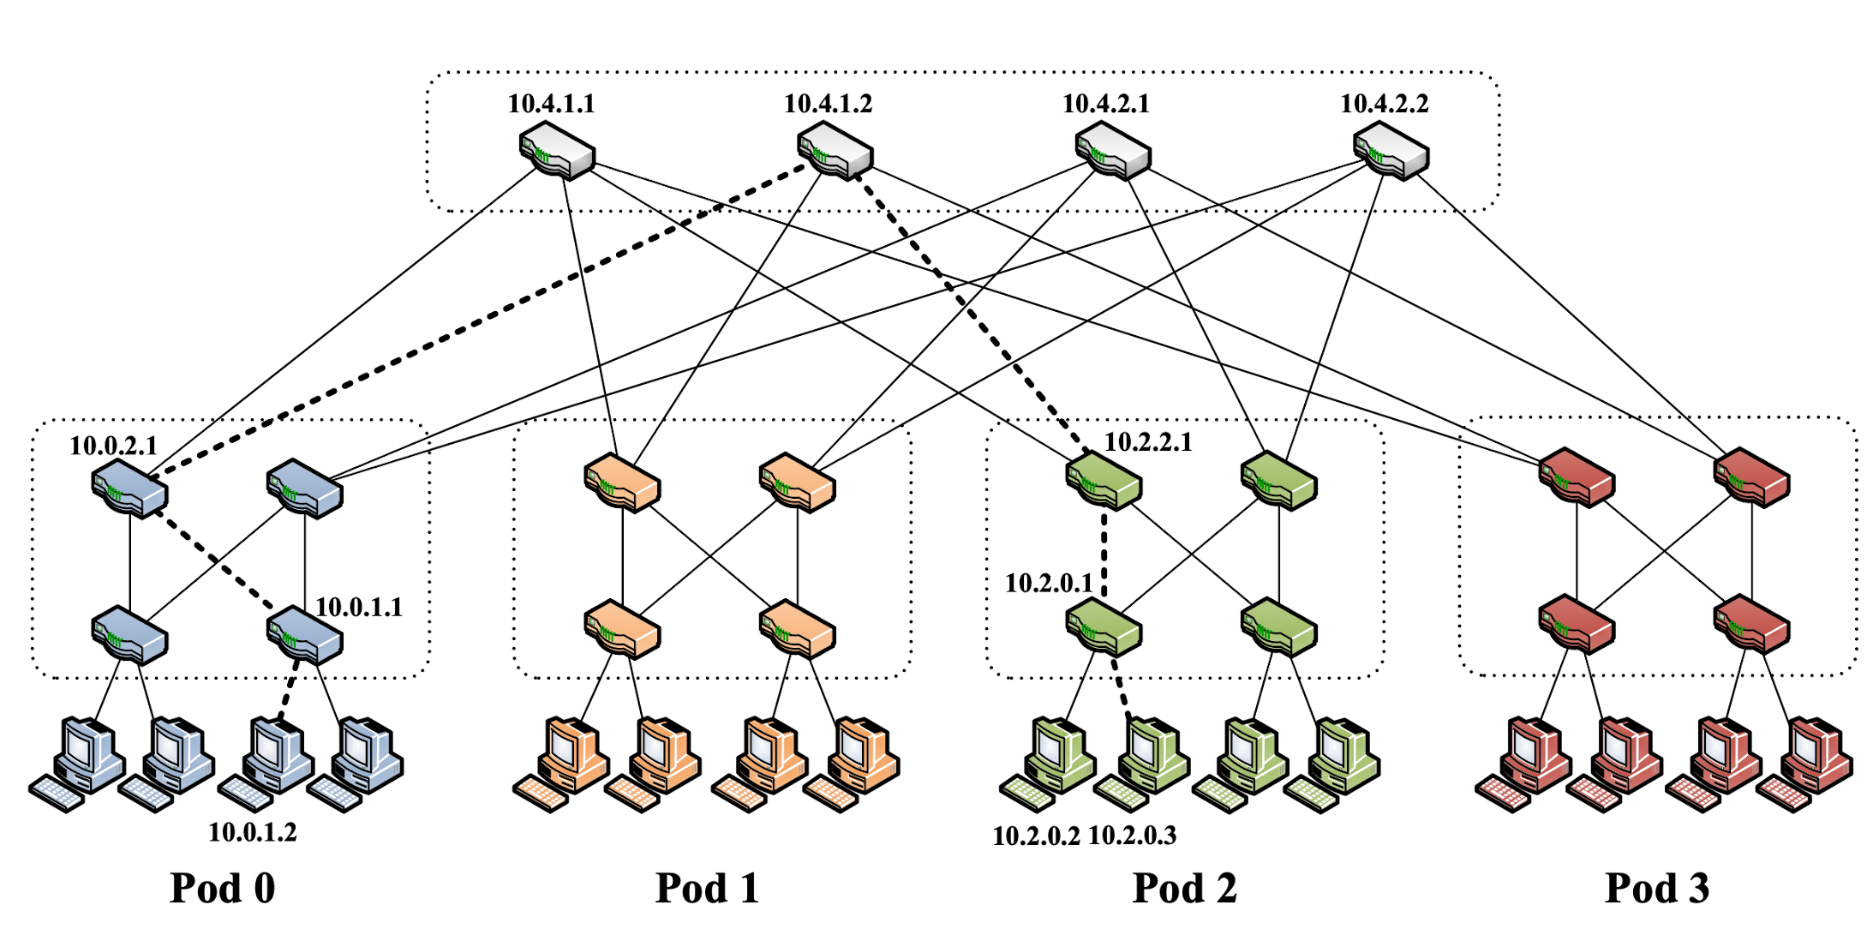


Evolution of Clos Networks for DC
ACM SIGCOMM 2008

Slide 15
Evolution of Clos Networks for DC
ACM SIGCOMM 2008

